Slide 1
Taking AIM
Visual Models in Test Design
Robert Sabourin
President
AmiBug.Com, Inc.
Montreal, Canada
rsabourin@amibug.com

Slide 2



Taking AIM
Robert Sabourin , Software Evangelist
President
AmiBug.Com Inc.
Montreal, Quebec, Canada
rsabourin@amibug.com
www.amibug.com

Slide 3

Edsger W. Dijkstra
“Program testing can be used to show the presence of bugs, but never to show their absence”

Slide 4
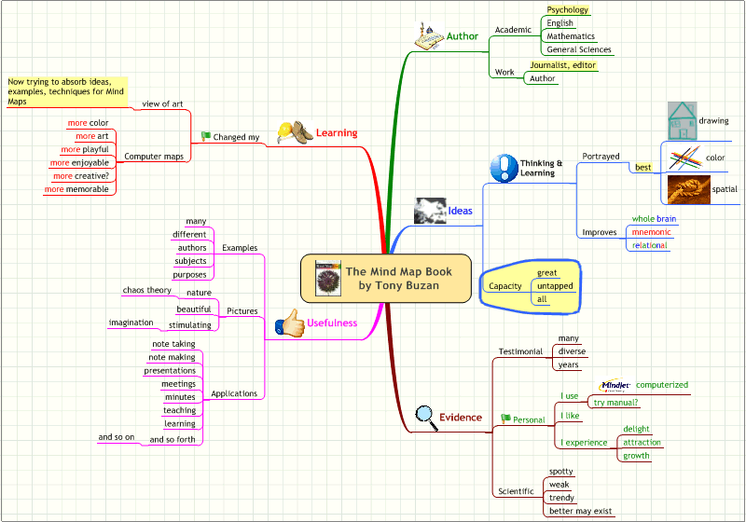

Tony Buzan

Slide 5
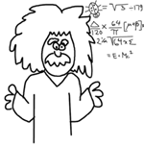
Taking AIM
Testing Approaches
Equivalence Classes
Usage Scenarios
Quality Factors

Slide 6

Taking AIM
Requirements
  Use cases
  Functional requirements
  Quality factors
  Constraints
  Written requirements
  Implicit requirements

Slide 7
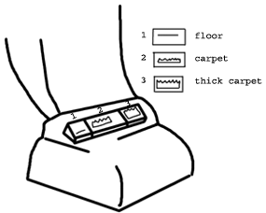
Taking AIM
Usage Scenarios
  Identify classes of users
  Identify how users will use system
  Describe scenarios
  Use Story board or similar approaches
  Identify variations

Slide 8
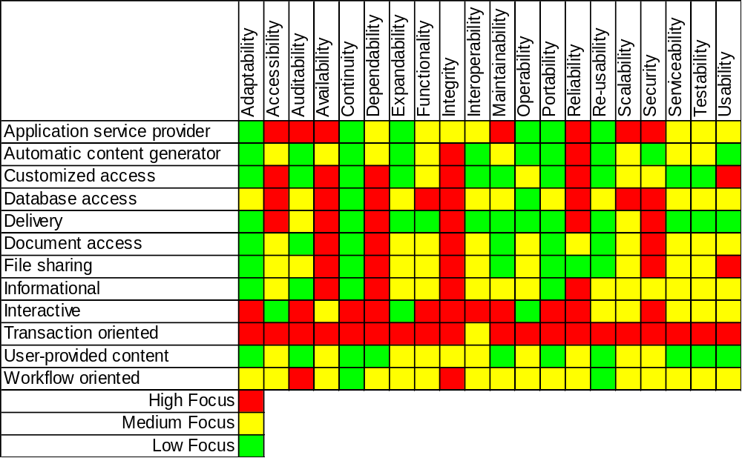
Quality Factors Importance
Different Application Types

Slide 9
Taking AIM
Equivalence Classes

Slide 10


Taking AIM
Equivalence class
  A subset of all possible test values to a variable
  Each member assumed provide the same info
  Each variable may have many classes
  Equivalence class are not mutually exclusive
  Focus testing
  Reduce the number of test cases

Slide 11
Sets – Venn Diagram
Equivalence Classes
a
b
c
a
a
b
d
f
b
c
c
d
e

Slide 12

Equivalence Classes
Equivalence
  Sources
    Requirements
      Business logic
      Capabilities
      Ranges
      Constraints
    Code
      Decisions
      Intermediate computations
    Data
      Input fields
      Database
      Internal structures

Slide 13

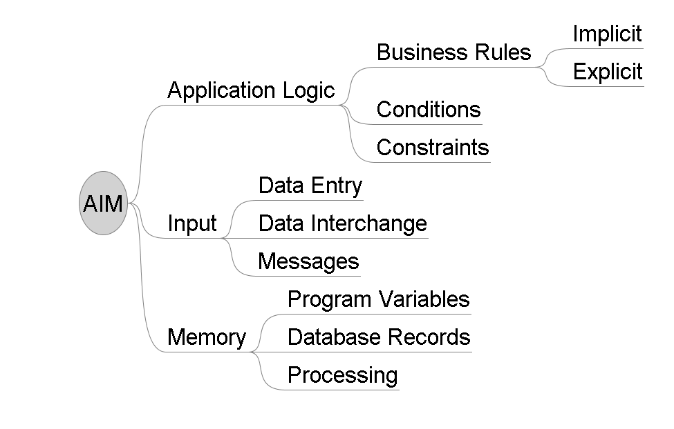
AIM - Equivalence Classes

Slide 14
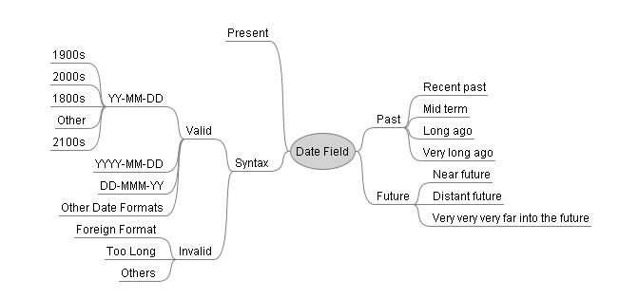
Example: Date Field
Equivalence Classes
Mind Map

Slide 15
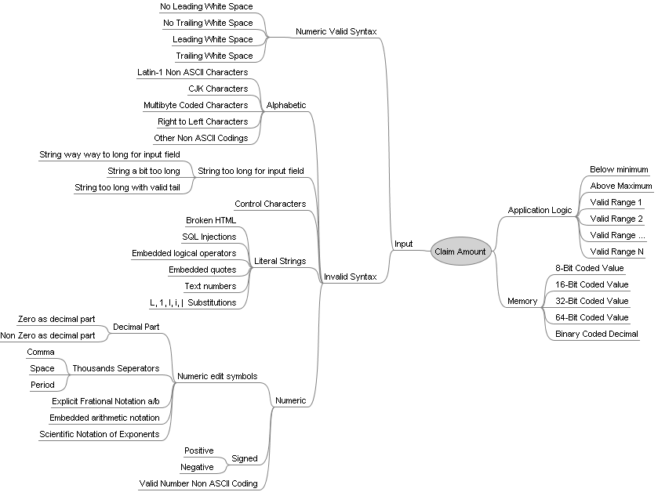
Example: Claim Amount
Equivalence Classes
Mind Map

Slide 16
Taking AIM
Usage Scenarios

Slide 17
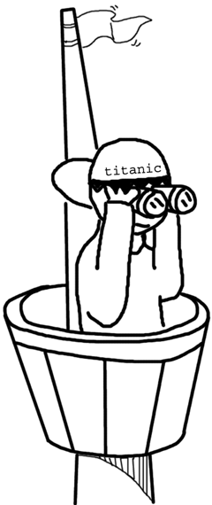
Scenario Based Testing
Scenarios
  Typical, real, usage scenarios for each user type
    Could be based on Use Case Analysis
    or Story Boards
  Individual scenarios can cover many functions!

Slide 18
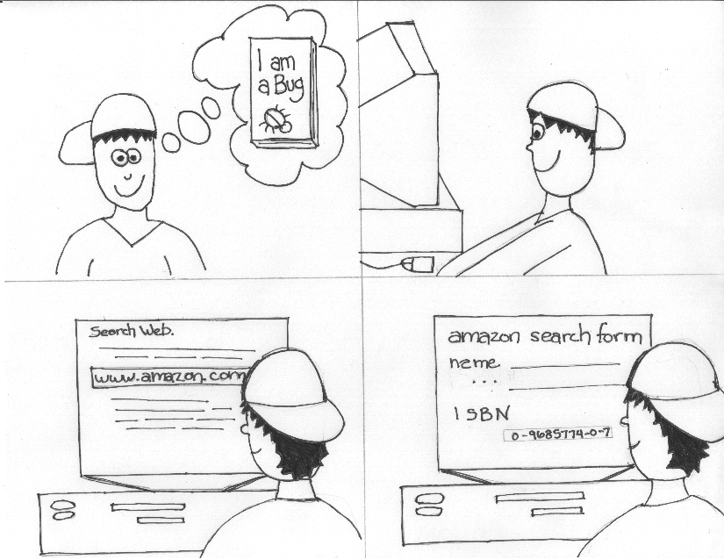

Slide 19
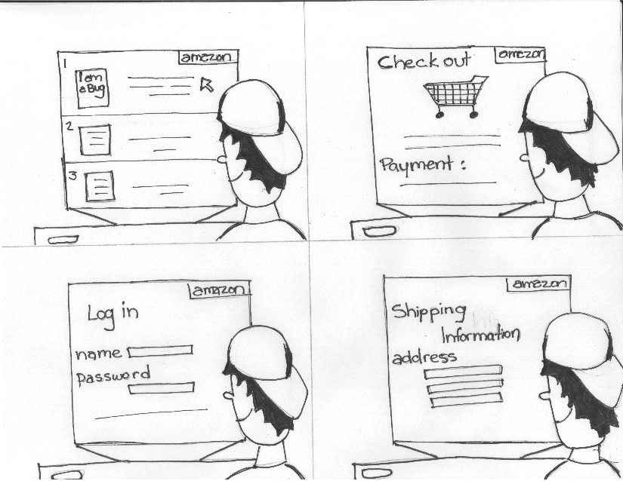

Slide 20
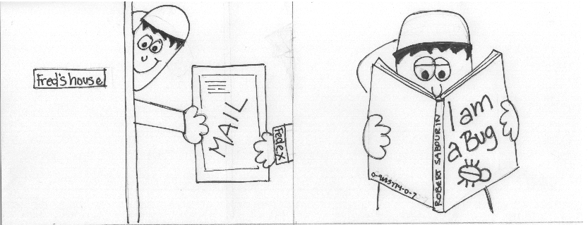

Slide 21
Scenario Based Testing
User Experience Test Case
  Parameterize experience
  Walk through scenario from start to end
  Use pre selected input for each case
  Always run every test as if it were a user experience

Slide 22
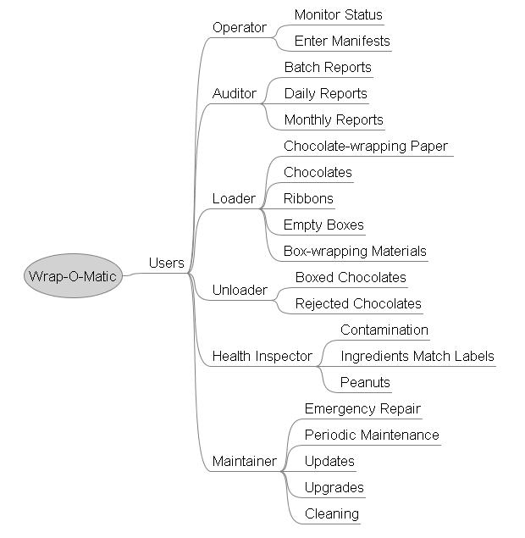
Scenario Based Testing

Slide 23
Taking AIM
Quality Factors

Slide 24
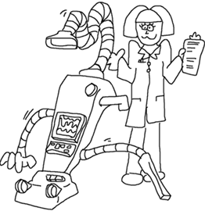
Usability Testing
Testing done to help design effective user interfaces
Part of software design process
Generally done by human factors and ergonomic experts
Checklist approaches, used in system testing

Slide 25
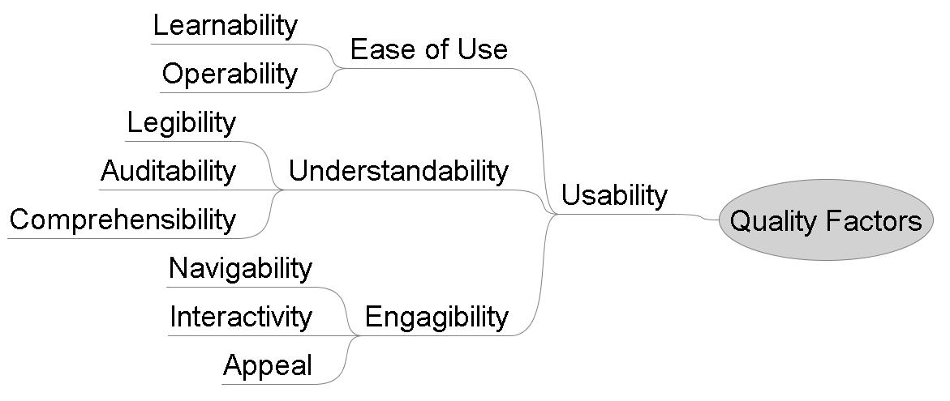
Taking AIM

Slide 26

Performance Testing
Verify and measure applications performance
Response time from input event to outcome
Throughput or volume (transactions/time)
Operational characteristics
Often automated!

Slide 27

Stress Testing
Testing operational characteristics of application within a harshly constrained environment
  Limit processor speed
  Limit memory
  Limit disk space
  Diminish access to shared resources

Slide 28

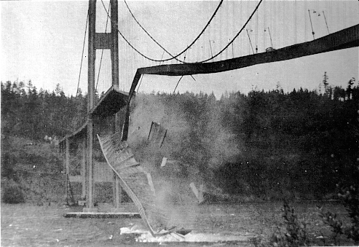
Analysis & Design
Quebec City Bridge, 1916
  Construction collapse
  Stress due to scale
Tacoma Narrows, 1940
  Collapse during normal operation
  Stress due to instability
  Wind was only 42 mph

Slide 29
Taking AIM
Quality Factors
  Scale
  Meter
  Goal

Slide 30
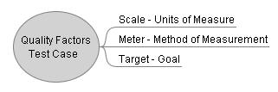
Taking AIM

Slide 31
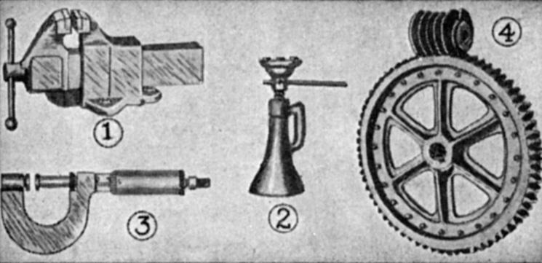
Measurements
Response time
  Minimum
  Maximum
  Average
CPU Usage
Memory
  available
  page faults/second
Disk
  % Disk Full

Slide 32
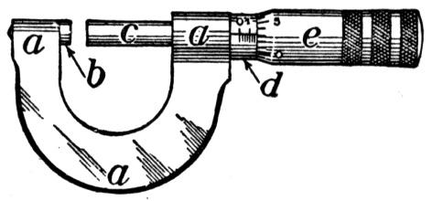
Measurements
Network
  Bandwidth
Web Servers
  Files/Sec
  Bytes/Sec
  Maximum Connections
  Errors

Slide 33
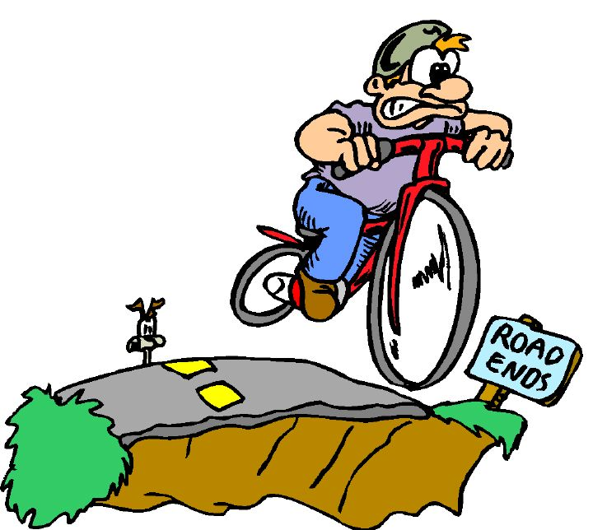
Measurements
Database Servers
  Transactions/Second
  Cache hit ratios
Functionality
  Pass?
  Fail?
  Relation to load

Slide 34
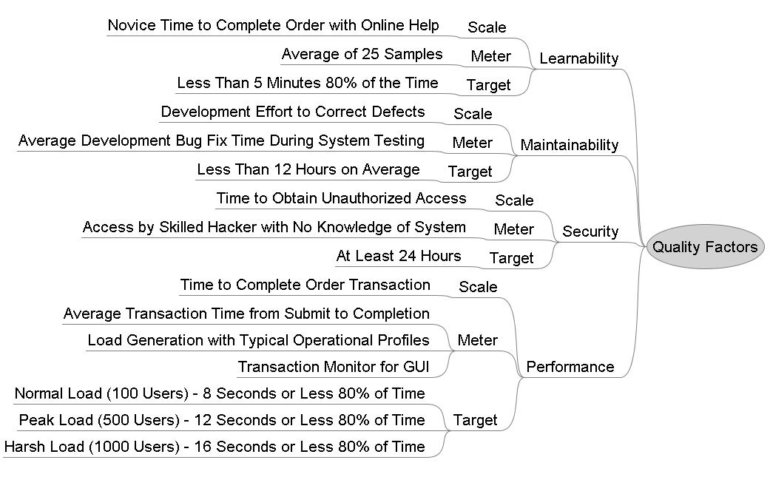
Taking AIM

Slide 35
Taking AIM
Comments about Mind Maps

Slide 36

Mind Maps
Some Benefits
  Visual
  Communication
  Creative
  Design Documentation
  Note taking

Slide 37
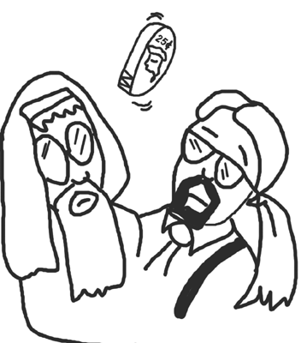
Mind Maps
Some Risks
  Models wrong but useful
  May be too big
  Possible incorrect focus
  Reuse out of context

Slide 38


Thank You
Questions?

